Slide 1
Annotation Strategies & Hack Assembly
Annotation Strategies, Hack Assembly Memory Representation, Multiplication Implementation Exercise

Slide 2
Lecture Outline
Strategies for Annotating Texts
  Motivation and Techniques for Annotation
Hack Assembly Language Review
  Registers, A-Instructions, Symbols, & C-Instructions
Hack Assembly Memory Representation
  I/O, Memory Mapping, External vs. Internal Memory
Multiplication Implementation Exercise
  Multiplying Two Numbers in Hack Assembly

Slide 3

Annotating Your Texts
WHY DO WE CARE?!
WHAT
Intentionality of interacting with a text to enhance the reader's understanding of, recall of, and reaction to the text

Slide 4
Annotating Your Texts
WHY DO WE CARE?!
WHAT
Intentionality of interacting with a text to enhance the reader's understanding of, recall of, and reaction to the text
HOW
  Highlighting, underlining or using [brackets] to note key points or ideas

Slide 5
Annotating Your Texts
WHY DO WE CARE?!
WHAT
Intentionality of interacting with a text to enhance the reader's understanding of, recall of, and reaction to the text
HOW
  Highlighting, underlining or using [brackets] to note key points or ideas
  Circling unfamiliar words or confusing parts of the text

Slide 6
Annotating Your Texts
WHY DO WE CARE?!
WHAT
Intentionality of interacting with a text to enhance the reader's understanding of, recall of, and reaction to the text
HOW
  Highlighting, underlining or using [brackets] to note key points or ideas
  Circling unfamiliar words or confusing parts of the text
  Paraphrasing or summarizing passages/chapters/sections

Slide 7
Annotating Your Texts
WHY DO WE CARE?!
WHAT
Intentionality of interacting with a text to enhance the reader's understanding of, recall of, and reaction to the text
HOW
  Highlighting, underlining or using [brackets] to note key points or ideas
  Circling unfamiliar words or confusing parts of the text
  Paraphrasing or summarizing passages/chapters/sections
  Commenting or reacting to the text 🤯

Slide 8
Lecture Outline
Strategies for Annotating Texts
  Motivation and Techniques for Annotation
Hack Assembly Language Review
  Registers, A-Instructions, Symbols, & C-Instructions
Hack Assembly Memory Representation
  I/O, Memory Mapping, External vs. Internal Memory
Multiplication Implementation Exercise
  Multiplying Two Numbers in Hack Assembly

Slide 9

The Hack Computer
The hardware you will build
  16-bit word size
  ROM: sequence of instructions
    ROM[0], RAM[1]…
  RAM: data sequence
    RAM[0], RAM[1]…
COMPUTER
MEMORY
CPU
ROM
(16-bit Instructions, Read-Only)
1110001011111100
REGISTERS
RAM
(16-bit Data, Read/Write)
1100101010010101
A/M
D
SCREEN
CONTROL
KEYBOARD
PC
9

Slide 10
The Hack Machine Language
Two types of instructions (16-bit)
  A-instructions load data
  C-instructions perform computations
Program: sequence of instructions
COMPUTER
MEMORY
CPU
ROM
(16-bit Instructions, Read-Only)
1110001011111100
REGISTERS
RAM
(16-bit Data, Read/Write)
1100101010010101
A/M
D
SCREEN
CONTROL
KEYBOARD
PC
10

Slide 11
Hack: Control Flow
Startup
  Hack instructions loaded into ROM
  Reset signal initializes computer state (instruction 0)
Execution
  Usually, advance to next instruction each cycle
  On jump instruction, write a different address into the PC
0
1
2
3
4
5
6
7
...
0101110011100110
1011000101010100
1110001011111100
0101110101101110
0001011000111010
0010111011011001
0110111110101001
0001110010110110
ROM (Instructions)

Slide 12
Hack: Registers
D Register: For storing Data
A Register: For storing data and Addressing memory
M “Register”: The 16-bit word in Memory currently being referenced by the address in A
RAM
1100101010010101
...
106
107
108
109
110
...
REGISTERS
M
A
108
D

Slide 13
Hack: A-Instructions
Syntax:
value can either be:
  A decimal constant
  A symbol referring to a constant
Semantics:
  Stores value in the A register
@value

Slide 14
Hack: A-Instructions
Symbolic Syntax
  Loads a value into the A register
Example:
Binary Syntax
@value
0000000000010101
Family:
A-Instruction
Value:
Binary encoding of 21
A Register
D Register
...
@21
...
0
0
A Register
D Register
21
0

Slide 15
Hack: Symbols
Symbols are simply an alias for some address
  Only in the symbolic code—don’t turn into a binary instruction
  Assembler converts use of that symbol to its value instead
Example:
LOOP = 02
00
01
02
03
04
@3
D=0
(LOOP)
@21
D=1
@LOOP
...
00
01
02
03
04
0000000000000011
1110101010010000
0000000000010101
1110111111010000
0000000000000010
...
Assemble

Slide 16
Hack: Built-In Symbols
Using ( ) defines a symbol in ROM / Instructions
Assembler knows a few built-in symbols in RAM / Data
R0, R1, ..., R15: Correspond to addresses at the very beginning of RAM (0, 1, …, 15)
  “Virtual registers,” Useful to store variables
SCREEN, KBD: Base of I/O Memory Maps
Example:
A Register
D Register
...
@R3
...
0
0
A Register
D Register
3
0

Slide 17
Hack: C-Instructions
Syntax: (dest and jump optional)
  dest is a combination of destination registers:
  comp is a computation:
  jump is an unconditional or conditional jump:
Semantics:
  Computes value of comp
  Stores results in dest (if specified)
  If jump is specified and condition is true (by testing comp result), jump to instruction ROM[A]
dest = comp ; jump
M, D, MD, A, AM, AD, AMD
0, 1, -1, D, A, !D, !A, -D, -A, D+1, A+1, D-1, A-1, D+A, D-A, A-D, D&A, D|A, M, !M, -M, M+1, M-1, D+M, D-M, M-D, D&M, D|M
JGT, JEQ, JGE, JLT, JNE, JLE, JMP

Slide 18
Hack: C-Instructions Example
A Register
D Register
55
56
00
01
(EXAMPLE)
@55
D=A+1

Slide 19
Hack: C-Instructions Example
A Register
D Register
55
56
00
01
02
03
(EXAMPLE)
@55
D=A+1
@R2
M=D
RAM
0
?
A Register
D Register
1
?
2
56
2
56
...

Slide 20
Hack: C-Instructions Example
A Register
D Register
55
56
00
01
02
03
04
05
(EXAMPLE)
@55
D=A+1
@R2
M=D
@EXAMPLE
D;JGT
RAM
0
?
A Register
D Register
1
?
2
56
2
56
...
A Register
D Register
0
56
(Will jump to instruction 0, since D > 0)

Slide 21
Hack: C-Instructions
Symbolic:
Binary:
dest = comp ; jump
1 1 1 a c1 c2 c3 c4 c5 c6 d1 d2 d3 j1 j2 j3
Family:
C-Instruction
Unused
Comp:
ALU Operation (a bit chooses between A and M)
Dest:
Where to store result
Jump:
Condition for jumping

Slide 22
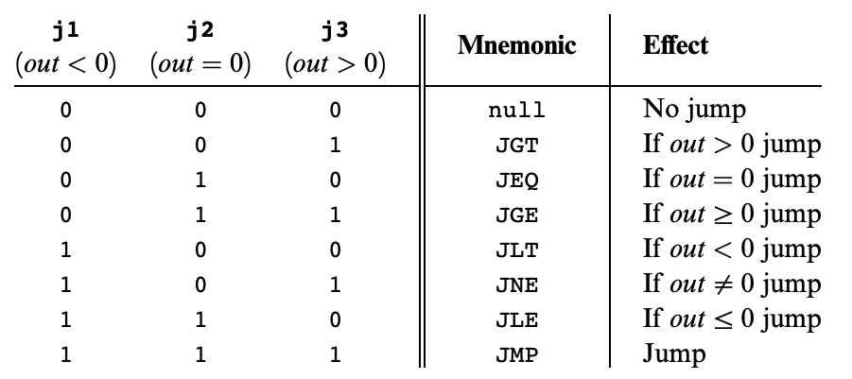
Hack: C-Instructions
Symbolic:
Binary:
dest = comp ; jump
1 1 1 a c1 c2 c3 c4 c5 c6 d1 d2 d3 j1 j2 j3
Jump:
Condition for jumping
Chapter 4

Slide 23
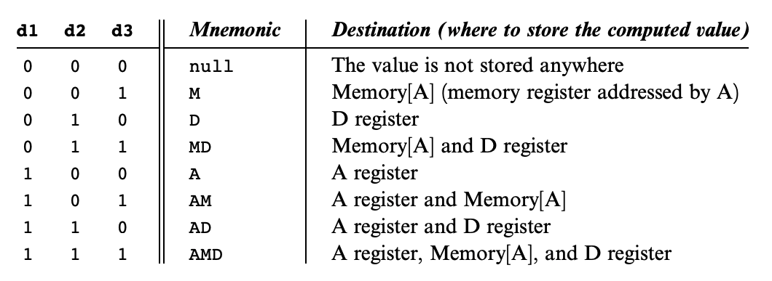
Hack: C-Instructions
Symbolic:
Binary:
dest = comp ; jump
1 1 1 a c1 c2 c3 c4 c5 c6 d1 d2 d3 j1 j2 j3
Dest:
Where to store result
Chapter 4

Slide 24
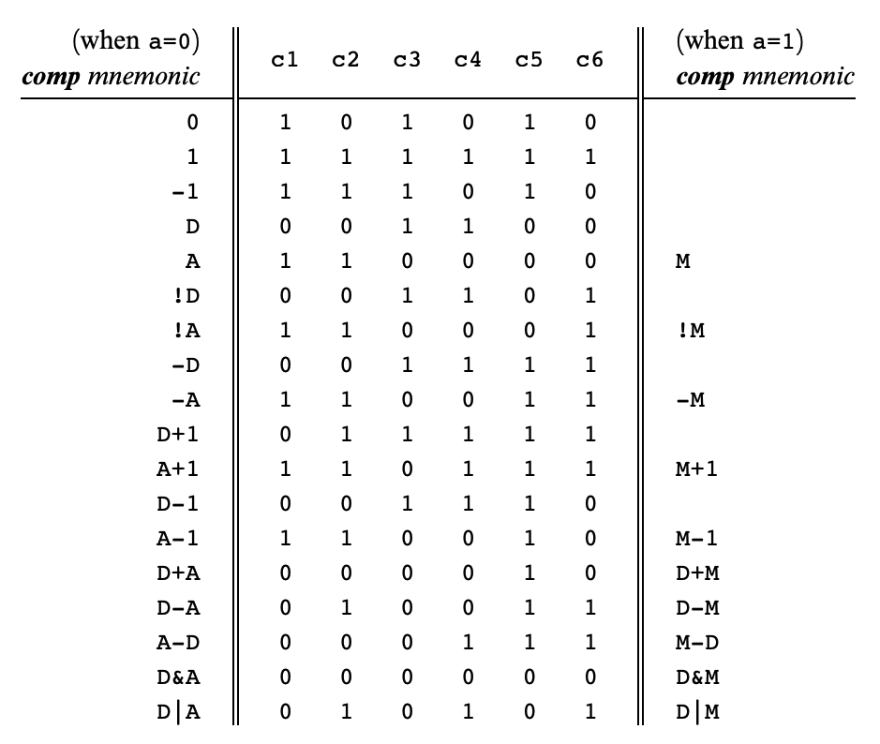
Hack: C-Instructions
Symbolic:
Binary:
dest = comp ; jump
1 1 1 a c1 c2 c3 c4 c5 c6 d1 d2 d3 j1 j2 j3
Comp:
ALU Operation (a bit chooses between A and M)
Chapter 4
Important: just pattern matching text!
Cannot have “1+M”

Slide 25
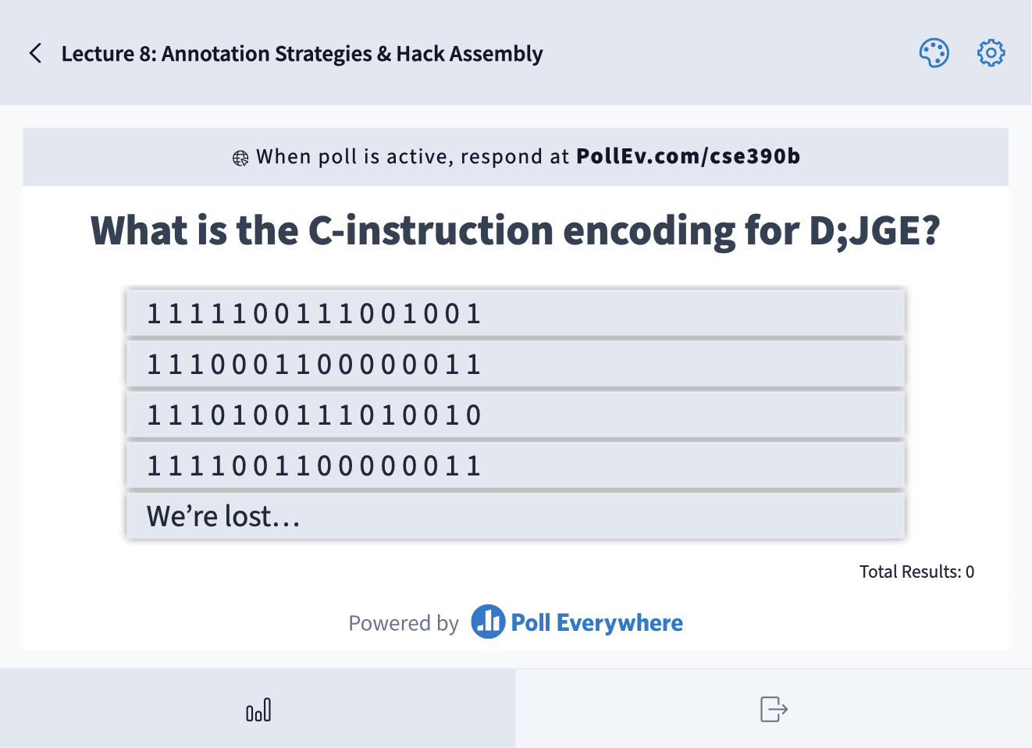
What is the C-instruction encoding for D;JGE?
1 1 1 1 1 0 0 1 1 1 0 0 1 0 0 1
1 1 1 0 0 0 1 1 0 0 0 0 0 0 1 1
1 1 1 0 1 0 0 1 1 1 0 1 0 0 1 0
1 1 1 1 0 0 1 1 0 0 0 0 0 0 1 1
We’re lost…

Slide 26
What is the C-instruction encoding for D;JGE?

Slide 27
Lecture Outline
Strategies for Annotating Texts
  Motivation and Techniques for Annotation
Hack Assembly Language Review
  Registers, A-Instructions, Symbols, & C-Instructions
Hack Assembly Memory Representation
  I/O, Memory Mapping, External vs. Internal Memory
Multiplication Implementation Exercise
  Multiplying Two Numbers in Hack Assembly

Slide 28
Hack Assembly: Input / Output
Two memory maps are created for you by underlying hardware
  SCREEN is a huge map where each pixel is one bit
  KEYBOARD is a single 16-bit word map with code of current key
Example:
@KBD
D=M
@SCREEN
M=D
D contains code of current key (e.g., 67 for “C”)
First 16 bits of screen (top left) show binary for 67

Slide 29
Hack: Input / Output
I/O is memory mapped
  Corresponds to some region of RAM
  Low-level drivers are constantly refreshing
COMPUTER
MEMORY
CPU
ROM
1110001011111100
REGISTERS
RAM
1100101010010101
0110010101100000
1101010010111001
0010110101001000
1010001001001000
1101101111101001
A/M
D
SCREEN
CONTROL
KEYBOARD
PC

Slide 30
Hack: Memory Mapped Output
Each bit of the screen memory map corresponds to one pixel (1 = black, 0 = white)
The start of the memory map is accessible via the SCREEN symbol in Hack.asm
RAM
1100101010010101
0110010101100000
1101010010111001
0010110101001000
1010001001001000
1101101111101001
SCREEN

Slide 31
Hack: External Memory Abstraction
Programmer sees one RAM32K memory region
  Only 16K + 8K + 1 words are being used
Split into three parts: SCREEN, KEYBOARD, and the rest
  Screen: 8K words
  Keyboard: 1 words
  The rest: 16K words (used for data and instructions)
Programmer can use the same interface to interact with the SCREEN, KEYBOARD, or normal RAM
  Just specify address, value, and other inputs
  Address determines what part we are interacting with

Slide 32
Hack: Internal Memory Implementation
In reality, separate memory chips for memory devices is unnecessary
  “Drivers” are code relaying changes in memory values to the device
In Hack, it’s not as simple as one RAM32K chip
  Use internal SCREEN and KEYBOARD chips so our virtual computer can detect and show changes in the screen and keyboard
Our memory chip has three subchips: SCREEN, KEYBOARD, and RAM16K
  Process the address given by the programmer and relay the request to the appropriate subchip

Slide 33
Hack: Memory Abstraction User View
RAM
1100101010010101
0110010101100000
1101010010111001
0010110101001000
1010001001001000
1101101111101001
0010110101001000
1010001001001000
0010110101001000
1101101111101001
0010110101001000
1010001001001000
0010110101001000
1010001001001000
1101101111101001
0010110101001000
1010001001001000
1101101111101001
USER
Screen address
Keyboard address

Slide 34
Hack: Memory Abstraction Internal View
RAM
RAM16K
1100101010010101
0110010101100000
1101010010111001
0010110101001000
1010001001001000
1101101111101001
SCREEN
1100101010010101
0110010101100000
1101010010111001
USER
IMPLEMENTATION
KEYBOARD
1100101010010101

Slide 35
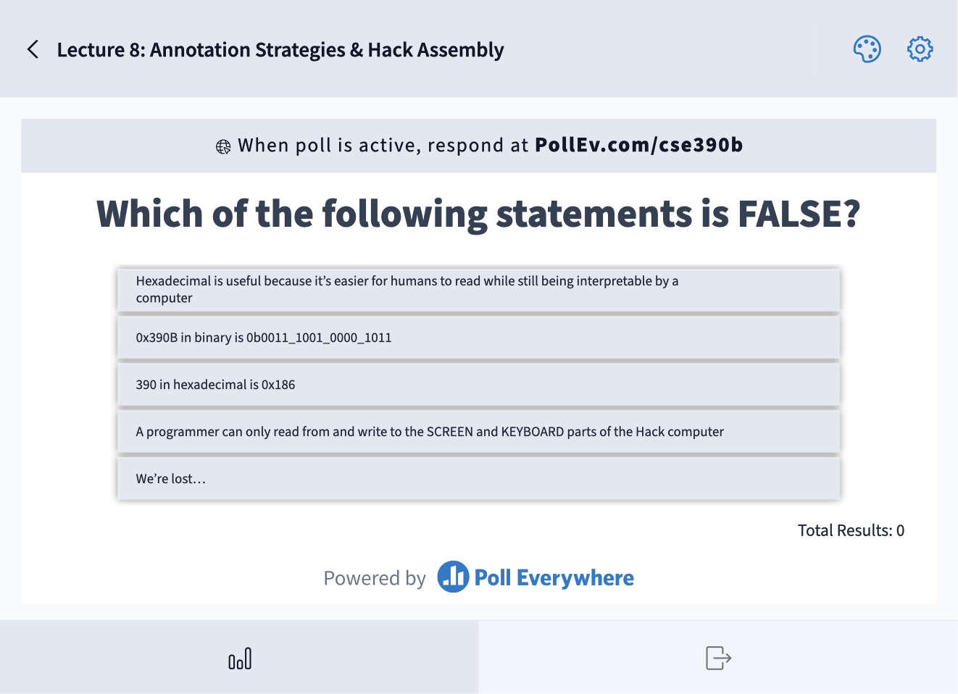
Which of the following statements is FALSE?
Hexadecimal is useful because it’s easier for humans to read while still being interpretable by a computer
0x390B in binary is 0b0011_1001_0000_1011
390 in hexadecimal is 0x186
A programmer can only read from and write to the SCREEN and KEYBOARD parts of the Hack computer
We’re lost…

Slide 36
Lecture Outline
Strategies for Annotating Texts
  Motivation and Techniques for Annotation
Hack Assembly Language Review
  Registers, A-Instructions, Symbols, & C-Instructions
Hack Assembly Memory Representation
  I/O, Memory Mapping, External vs. Internal Memory
Multiplication Implementation Exercise
  Multiplying Two Numbers in Hack Assembly

Slide 37
Exercise: Implementing Multiplication
Write a program that multiplies R0 and R1 and stores the result in R2
  Remember we don’t have a multiply operation
  We will have to use add and loops to get the job done
Roadmap
  Start with pseudocode using if statements, loops, etc.
  Remove conditionals and loops by using jumps in pseudocode
  Convert pseudocode to assembly

Slide 38
Exercise: Implementing Multiplication
Goal: Implement R0 × R1 = R2
Pseudocode | Hack Assembly

Slide 39
Exercise: Implementing Multiplication
Goal: Implement R0 × R1 = R2
Pseudocode | Hack Assembly
Approach: add R0 to the result R1 times

Slide 40
Exercise: Implementing Multiplication
Goal: Implement R0 × R1 = R2
Pseudocode | Hack Assembly
Approach: add R0 to the result R1 times
R2 = 0
while (R1 > 0) {
R2 = R0 + R2
R1 = R1 - 1
}

Slide 41
Exercise: Implementing Multiplication
Remove loops from pseudocode
Use labels to notate important sections of the code
Attempt 1: What happens when R1 is 0? What should happen?
START:
R2 = 0
LOOP:
R2 = R0 + R2
R1 = R1 - 1
IF R1 > 0 JMP LOOP
END:
INFINITE LOOP
R2 = 0
while (R1 > 0) {
R2 = R0 + R2
R1 = R1 - 1
}

Slide 42
Exercise: Implementing Multiplication
Remove loops from pseudocode
Use labels to notate important sections of the code
Attempt 1: What happens when R1 is 0? What should happen?
START:
R2 = 0
LOOP:
IF R1 <= 0
JMP to END
R2 = R0 + R2
R1 = R1 - 1
JMP LOOP
END:
INFINITE LOOP
R2 = 0
while (R1 > 0) {
R2 = R0 + R2
R1 = R1 - 1
}

Slide 43
Exercise: Implementing Multiplication
Convert to Hack Assembly
Memory (M):
 | 2 | 5
R0 | R1 | R2
START:
R2 = 0
LOOP:
IF R1 <= 0
JMP to END
R2 = R0 + R2
R1 = R1 - 1
JMP LOOP
END:
INFINITE LOOP
Registers:
D | A
(START)
@R2
M = 0
(LOOP)
(END)

Slide 44
Exercise: Implementing Multiplication
Convert to Hack Assembly
Memory (M):
 | 2 | 5
R0 | R1 | R2
START:
R2 = 0
LOOP:
IF R1 <= 0
JMP to END
R2 = R0 + R2
R1 = R1 - 1
JMP LOOP
END:
INFINITE LOOP
(START)
@R2
M = 0
(LOOP)
@R1
D = M
@END
D; JLE
(END)
Registers:
D | A

Slide 45
Exercise: Implementing Multiplication
Convert to Hack Assembly
(START)
@R2
M = 0
(LOOP)
@R1
D = M
@END
D; JLE
@R0
D = M
@R2
M = M + D
(END)
Memory (M):
 | 2 | 5
R0 | R1 | R2
START:
R2 = 0
LOOP:
IF R1 <= 0
JMP to END
R2 = R0 + R2
R1 = R1 - 1
JMP LOOP
END:
INFINITE LOOP
Registers:
D | A

Slide 46
Exercise: Implementing Multiplication
(START)
@R2
M = 0
(LOOP)
@R1
D = M
@END
D; JLE
@R0
D = M
@R2
M = M + D
@R1
M = M - 1
@LOOP
0; JMP
(END)
Convert to Hack Assembly
Memory (M):
 | 2 | 5
R0 | R1 | R2
START:
R2 = 0
LOOP:
IF R1 <= 0
JMP to END
R2 = R0 + R2
R1 = R1 - 1
JMP LOOP
END:
INFINITE LOOP
Registers:
D | A

Slide 47
Exercise: Implementing Multiplication
(START)
@R2
M = 0
(LOOP)
@R1
D = M
@END
D; JLE
@R0
D = M
@R2
M = M + D
@R1
M = M - 1
@LOOP
0; JMP
(END)
Convert to Hack Assembly
Memory (M):
 | 2 | 5
R0 | R1 | R2
START:
R2 = 0
LOOP:
IF R1 <= 0
JMP to END
R2 = R0 + R2
R1 = R1 - 1
JMP LOOP
END:
INFINITE LOOP
Registers:
D | A

Slide 48
Exercise: Implementing Multiplication
Convert to Hack Assembly
(START)
@R2
M = 0
(LOOP)
@R1
D = M
@END
D; JLE
@R0
D = M
@R2
M = M + D
@R1
M = M – 1
@LOOP
0; JMP
(END)
@END
0; JMP
Memory (M):
 | 2 | 5
R0 | R1 | R2
START:
R2 = 0
LOOP:
IF R1 <= 0
JMP to END
R2 = R0 + R2
R1 = R1 - 1
JMP LOOP
END:
INFINITE LOOP
Registers:
D | A

Slide 49
Lecture Outline
Hack Assembly Memory Representation
  I/O, Memory Mapping, External vs. Internal Memory
Hack Assembly Language Review
  Registers, A-Instructions, Symbols, & C-Instructions
Multiplication Implementation Exercise
  Multiplying Two Numbers in Hack Assembly
Project 5 Overview
  Specification Annotation, Machine Language, & Building Computer Memory

Slide 50
Project 5 Overview
Part I: Annotation
  Come prepared to your upcoming Student-TA 1:1 meeting to work on Project 5 (e.g., specification reading and identifying annotation strategies you would want to use)
Part II: Machine Language
  Implement Max.asm in Hack Assembly
Part III: Building Computer Memory
  Implement Memory.hdl in HDL
Part IV: Project 5 Reflection

Slide 51
Project 5, Part I: Annotation
Fill out the Assignment Timeline
  Divide up Project 5 into doable chunks for the days you plan to work on the assignment
  Describe each day’s task in as much detail as possible
Annotate the Project 5 Specification
  Identify five annotation strategies that you want to try
  Practice these strategies on the Project 5 specification
Complete Annotation Reflection Questions
  Reflect on the strategies you used and why or why not they were effective

Slide 52
Annotate the Project 5 Specification
We’ll provide you with an opportunity to start annotating the Project 5 specification in class now
Recall these annotation strategies:
  Highlighting, underlining or using [brackets] to note key points or ideas
  Circling unfamiliar words or confusing parts of the text
  Paraphrasing or summarizing passages/chapters/sections
  Commenting or reacting to the text 🤯

Slide 53
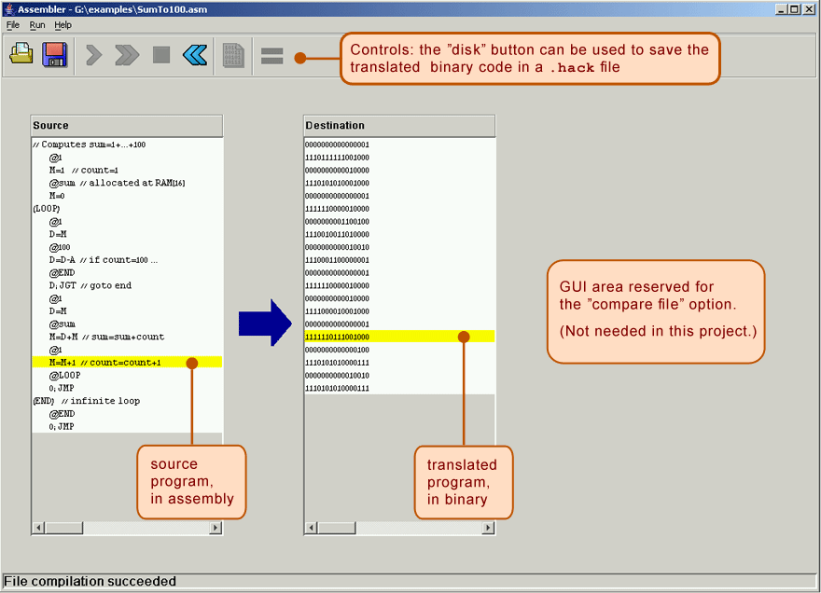
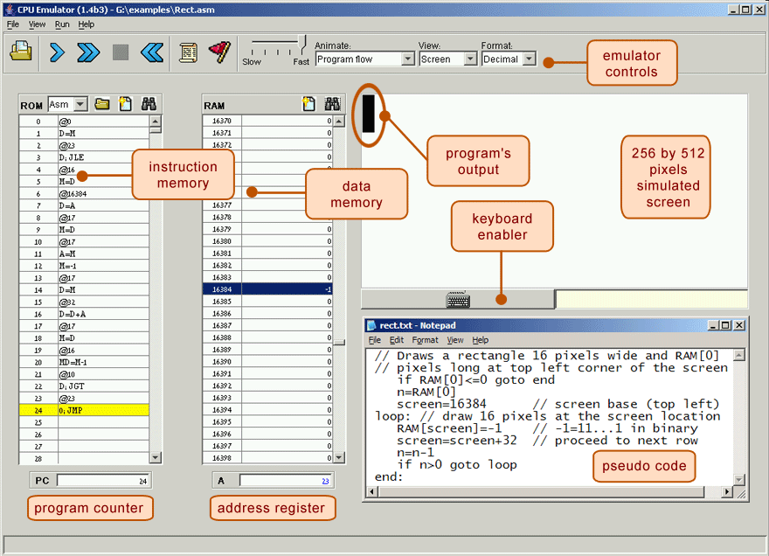
Project 5: Tools
The test scripts use the .hack files directly! Don’t let your .asm and .hack get out of sync!
Running a Test Script
(recommended flow):
Quickly Iterating or Experimenting:
Max.asm
Max.hack
Assembler
CPUEmulator
Max.asm
CPUEmulator
Can still “run” the program, even without a script

Slide 54
Post-Lecture 8 Reminders
Project 4 due tonight (4/20) at 11:59pm
Project 5 (Annotation, Machine Language, & Building Computer Memory) released today, due next Thursday (4/27) at 11:59pm
Today only: No office hours after class today (see Anam’s announcement)
  Please post any questions on the Ed board

